Slide 1







Instructions: You will hear a male and a female talker. Please select if the female talker says a word or a nonword.
Filler Trial
Critical Trial
logelai
inhabit
publi sh er
Era s er
Talker A
Talker B
Talker A
Talker B
N
W
Sh
S
Left
Participant
Right
Left
Participant
Right
Participant

Slide 2
logelai
romantic
Talker B
N
Participant
Right
Talker A
Left

Slide 3
Example Critical Trial
dino s aur
publi sh er
Talker A
Talker B
Sh
S
Instructions: You will hear a male and a female talker. Please select if the female talker says a word or a nonword.
Left
Participant
Right
Participant
Example Filler Trial
logelai
romantic
Talker A
Talker B
N
W
Left
Participant
Right

Slide 4
Talker A
Talker B
Talker B
Talker A
Sh
S
Sh
S
Left
Right
Left
Right
Sh
S
Sh
S
Left
Right
Left
Right
Left
Talker A
Talker B
Talker B
Talker A
S
Sh
S
Sh
Left
Right
Left
Right
S
Sh
S
Sh
Left
Right
Left
Right

Slide 5
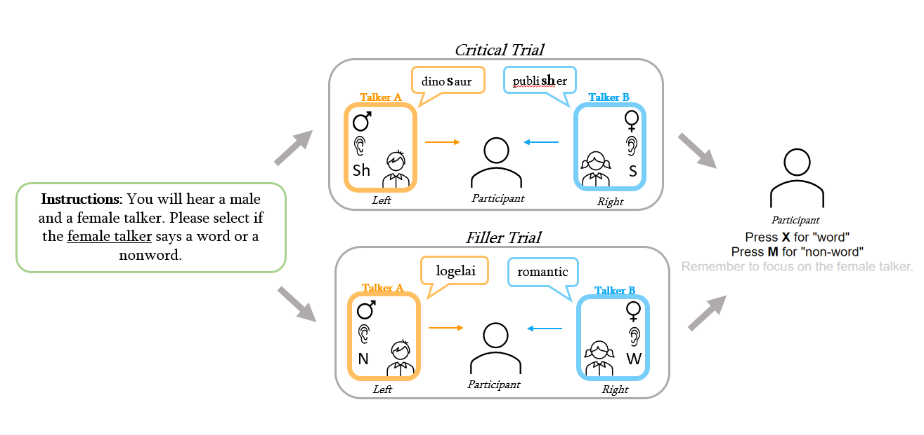
Figure 8: A visual diagram of a single trial. Participants will be instructed to attend to either the male or female talker at the beginning of the experiment (left, green box). Each subsequent exposure trial will feature two talkers, either in a critical trial (top) where both talkers produce a word that contains a s/sh sound, or a filler trial (bottom) where one talker produces a word and the other a nonword. The participant must then select if the Attended Talker produced a word or a nonword for each exposure trial (right).

Slide 6
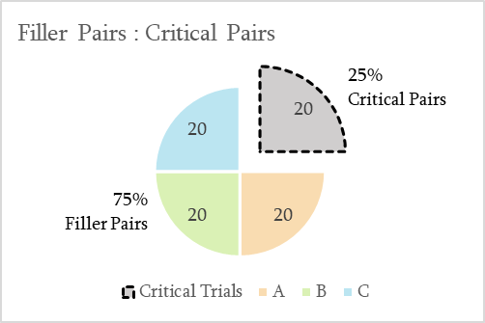
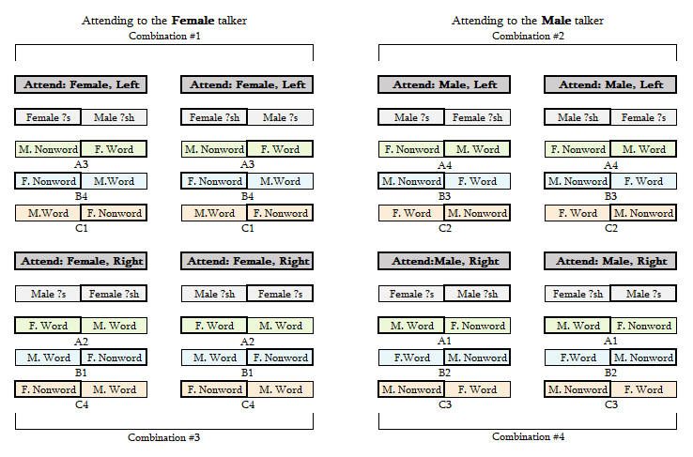
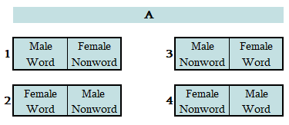
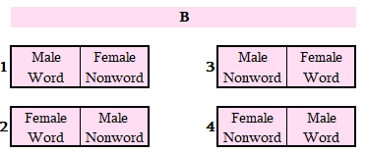
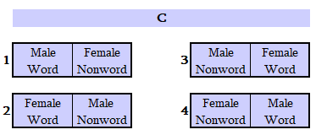
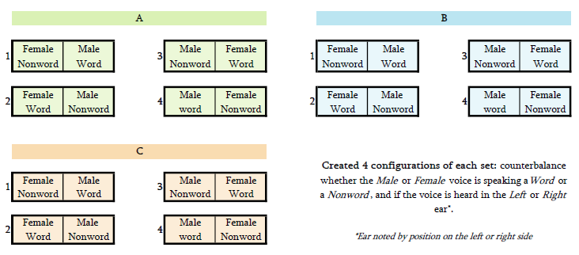
Figure 4c
Figure 4c: The break
Figure 5
Figure 6: The Set Version assigned to each Critical Item combination. The 20 Critical Items in each experiment are shown in gray, Set A in green, Set B in blue, and Set C in orange. The letter number combo below each pair (e.g., A3 below Set A in Combination #1 above) correlates to the Set and Version in Figure 4a. The ear the talker is presented in correlates to the position of the word in the pair (e.g., in Combination #1 above, the Female talker is presented in the Left Ear), and outline around the Attended Talker is bolded.
Figure 5: The 60 Filler Items (60 unique Word/Nonword pairs) used in this experiment were divided into 3 Sets (A, B, C) of 20 Filler Items. We created 4 Versions of each Set (1, 2, 3, 4) to produce every combination of factors—i.e., if the Male or Female voice speaking a Word or a Nonword, and if the voice is heard in the Left or Right Ear. The Version is noted by the number to the left of the set pair. The Ear presentation is represented by the horizontal position of the box within each pair (e.g., in A1 (Set A Version 1), the Female voice produces a Nonword in the Left Ear).

Slide 7
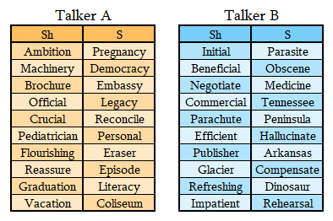
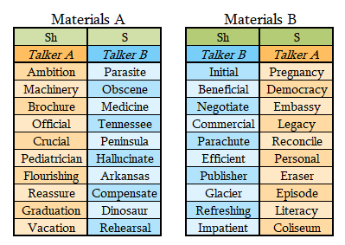
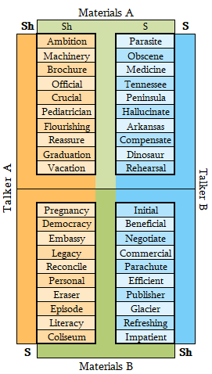
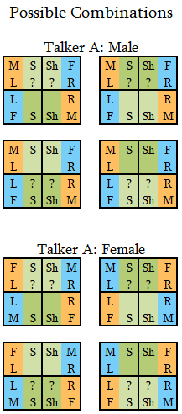
Figure 1b
Figure 1a
Figure 3a
Figure 1b: The lists of s and ʃ words that will be produced in Talker A’s voice (left) and Talker B’s voice (right).
Figure 3b
Figure 1a: How Talker words are paired into Critical Items and grouped into Materials A (left) and Materials B (right) to assign an ambiguous sound to half the Critical Items.
Figure 3a: A visual illustrating how the Critical Words spoken by Talker A and Talker B are divided into Materials A and Materials B. In this experiment, the words in Materials A are produced with an ambiguous sound and the words in Materials B are produced with an unambiguous sound. During the Critical Trials, each Talker is always heard in the same ear (e.g., Talker A in the Left Ear and Talker B in the Right Ear, as Shown above).
Figure 3b: Potential Configurations of factors. The “??” symbols represent which materials are assigned the ambiguous sound.

Slide 8
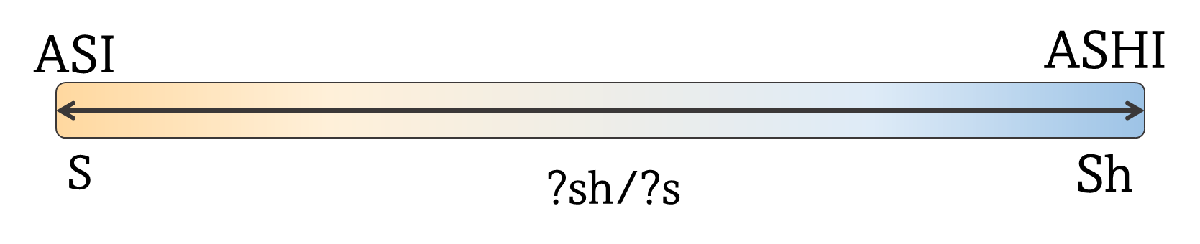
ASI
ASHI
S
?sh/?s
Sh
Talker B
Talker A
?s — Sh
S — ?sh
Figure 2: A visual illustrating how the /s/-/ʃ/ continuum is manipulated for Talker A and Talker B.

Slide 9
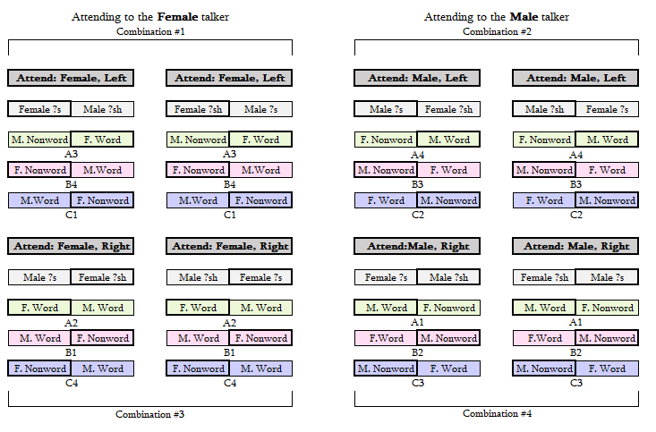
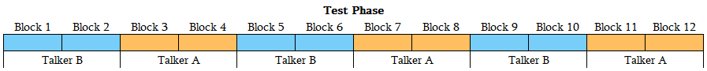
Figure 7: Each block has a total of 6 trials. Each item on the test continuum (asi-ashi) will play once in a randomized order before moving to the next block. The test continuum will be produced by both talkers 6 times each. Each talker will produce two blocks in a row before switching to the next to minimize additional strain on cognitive resources that may occur due to swapping between the two talkers. The talkers will alternate every two blocks. Which talker (male/female) speaks first will be counterbalanced within the experiment

Slide 10
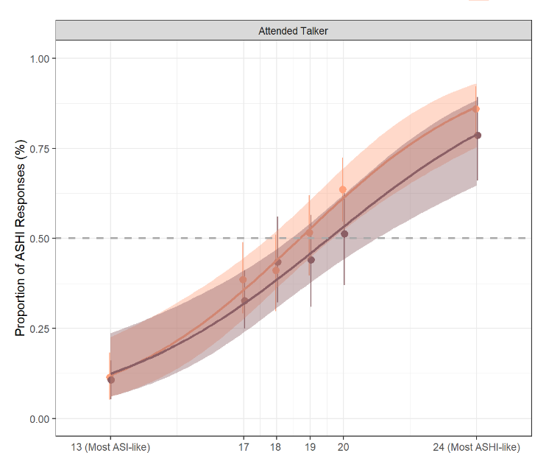

Slide 11
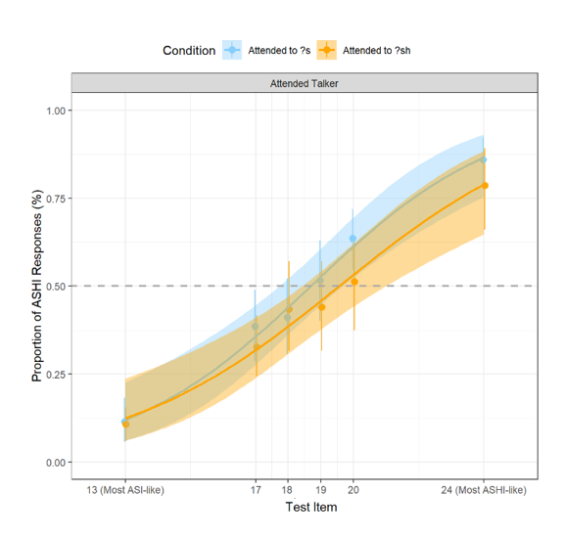
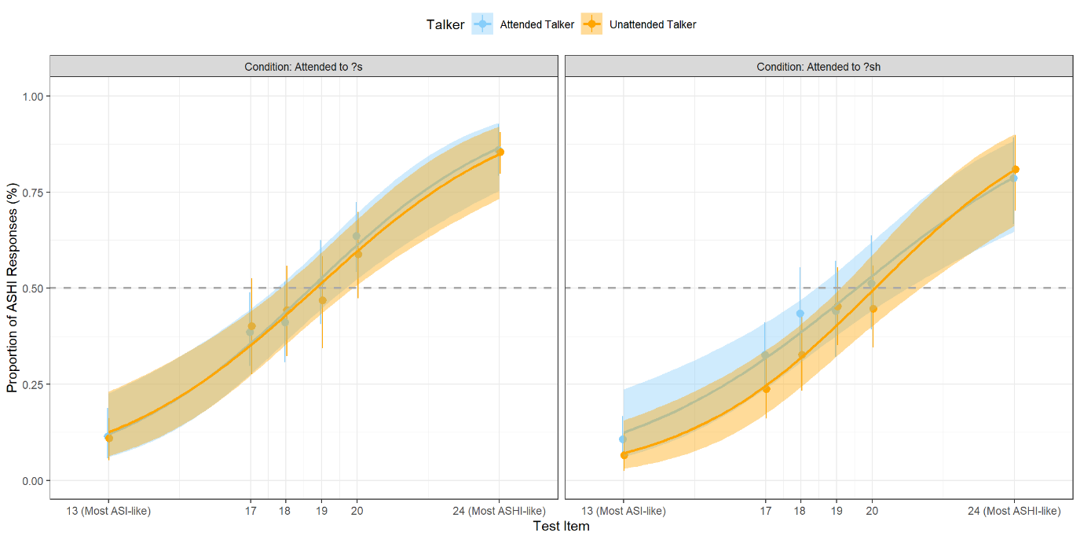
Figure 9: Compares the average proportion of ASHI responses by Test Item for the Attended Talker (blue) and the Unattended Talker (orange). The responses are separated by the ambiguous sound production of the Attended Talker (?s, left; ?sh, right); IN the left panel, the Attended talker produced an ambiguous S sound, and the Unattended Talker produced an ambiguous Sh sound. The inverse is true in the right panel. Each plotted point correlates to the calculated average number of ASHI responses for a given Test Item. The shading around the calculated psychometric curve represents a 95% confidence interval. The gray dashed line marks where the proportion of ASHI responses equals 50%; where the curves intercept this line represents the estimated perceptual boundary for the Talker, when participants are equally likely to respond either ASI or ASHI for that Test Item.
Figure 8: Compares the average proportion of ASHI responses by Test Item for the Attended Talker producing an ambiguous S sound (blue) or an ambiguous Sh sound (orange). Each plotted point correlates to the calculated average number of ASHI responses for a given Test Item. The shading around the calculated psychometric curve represents a 95% confidence interval. The gray dashed line marks where the proportion of ASHI responses equals 50%; where the curves intercept this line represents the estimated perceptual boundary for the Talker, when participants are equally likely to respond either ASI or ASHI for that Test Item.

Slide 12
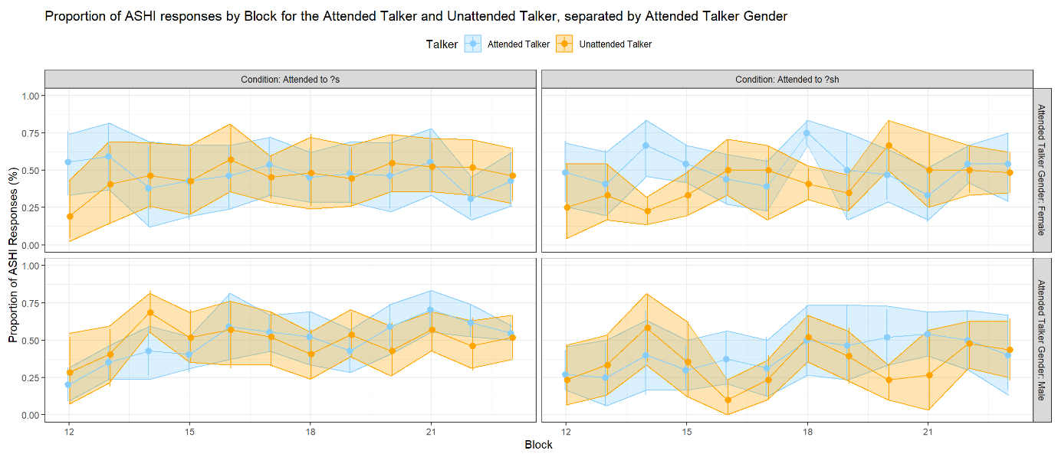
Figure 10 Compares the proportion of ASHI responses across participants by block for both the Attended Talker (blue) and the Unattended Talker (orange). The points represent the proportion of ASHI responses per block, and the shaded regions represents a 95% confidence interval. Proportion of ASHI responses are separated by the whether the Attended Talker produced an ambiguous S sound (left) or an ambiguous Sh sound (right), and by the Attended Talker Gender (Male, top; Female, bottom). Generally, the proportion of ASHI responses did not vary significantly between blocks, nor were they impacted by the ambiguous sound produced by the Attended Talker or the Talker gender.

Slide 13
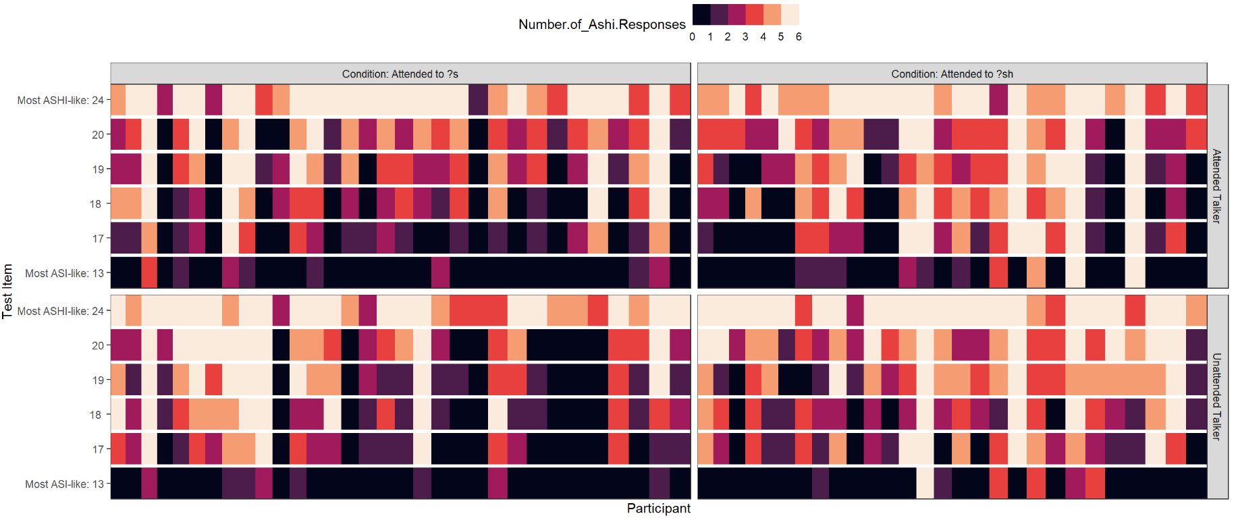
Figure 11: Color gradient illustrating the number of ASHI responses for each Test Item, separated by whether the Attended Talker produced an ambiguous S sound (left) or an ambiguous Sh sound (right), and whether the Test Item was produced in the voice of the Attended talker (top) or the Unattended Talker (bottom). Each column represents one participant; 32 participants attended to the talker who produced an ambiguous S sound, and 28 participants attended to the talker that produced an ambiguous Sh sound. Generally, the number of ASHI responses was high for the Test Item that were synthesized to sound most like ASHI (top row, lightest color), and low for the Test Item that were synthesized to sound most like ASI (bottom row; darkest color). However, the number of ASHI responses for the middle four Test Items (17, 18, 19, 20) appears more varied regardless of the ambiguous sound or the Talker.

Slide 14
